Slide 1
IJCAI 2020 Mahjong AI Competition
Mahjong Saint Team Report
Reporter: Wu Yu

Slide 2
Team honor
Development process
Fan Calculation
Self game judge system
Monte Carlo method
Simplify victory goal
CONTENTS
Rollout generation
Quick dividing
Model the opponent
Other things to say

Slide 3
Team honor

Slide 4
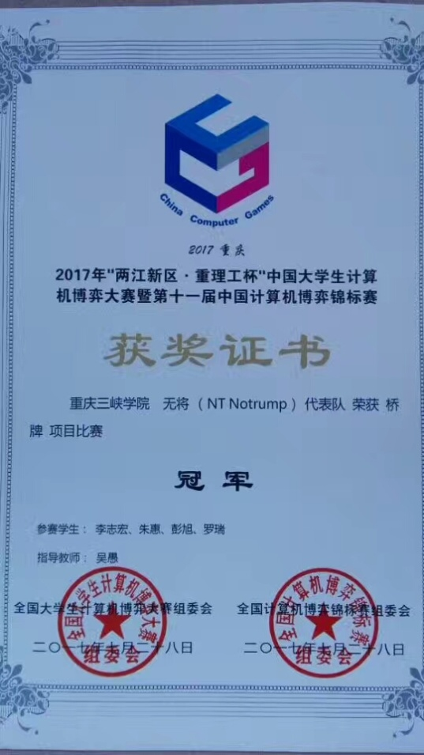
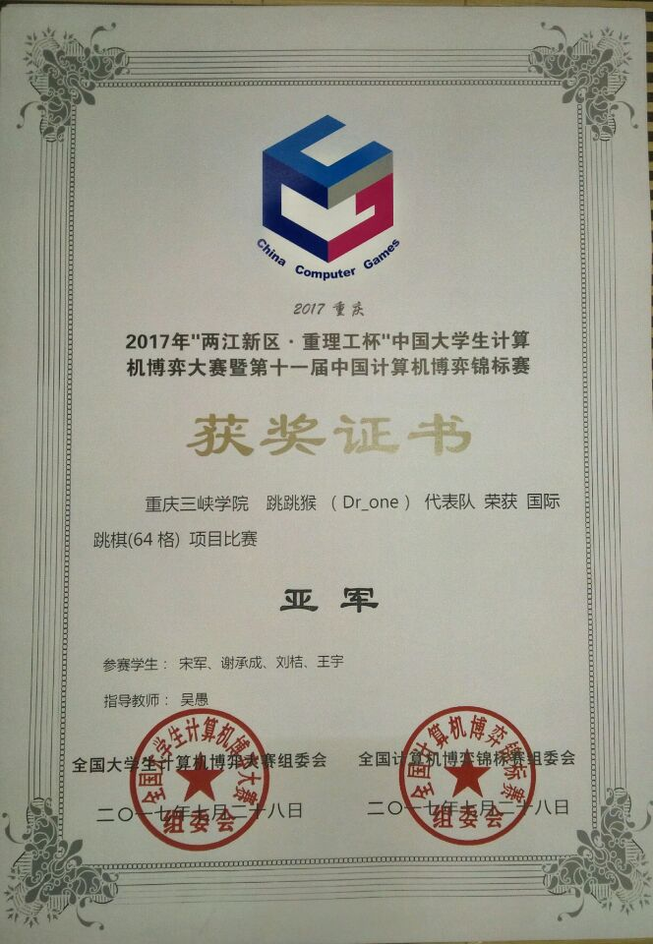
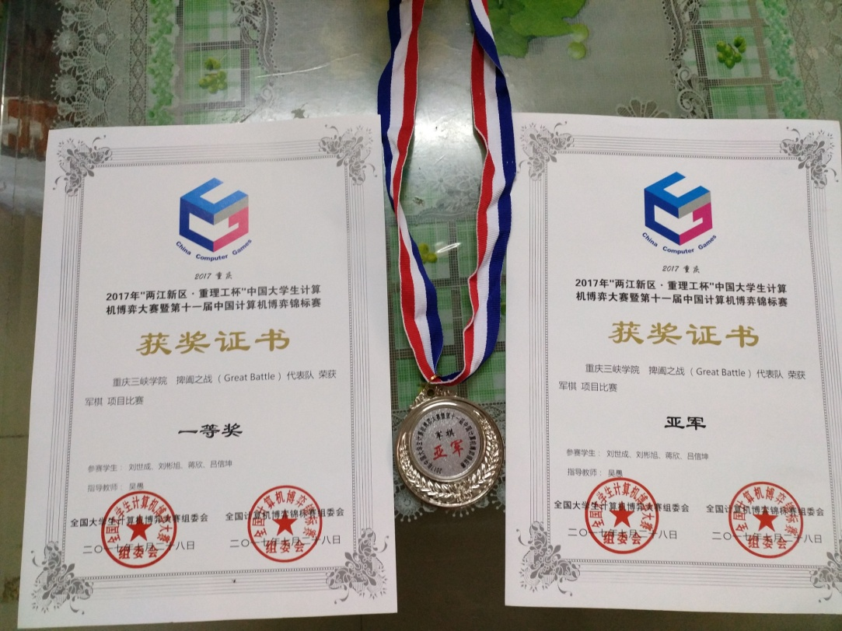

Slide 5
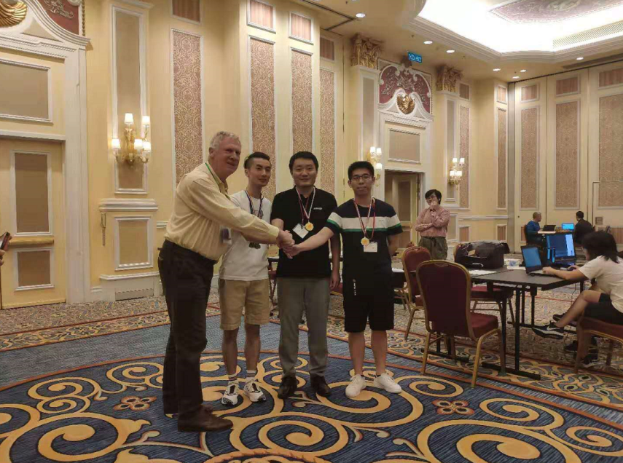
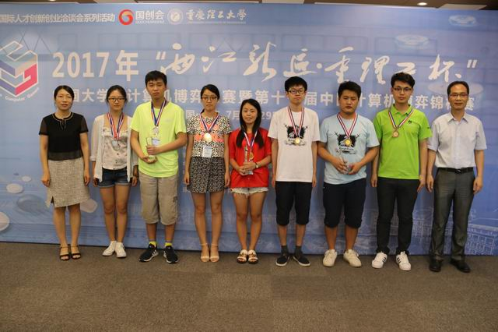
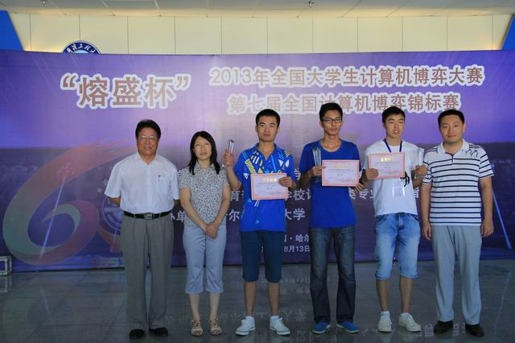
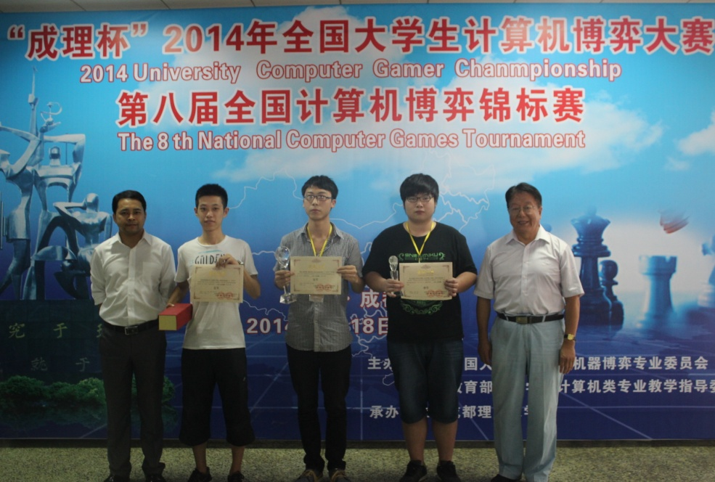

Slide 6
Development process

Slide 7
1
2020.2~2020.5 Designing and coding Mahjong AI. I was coding Monte Carlo method, simulating Mahjong game process and designing dividing tiles algorithm, etc. During that period, my AI was top in the Mahjong GB game ladder of botzone.
2
2020.5~2020.7 Adding more winning type of Fan, for example, half flush and two dragons. Stabilizing and strengthening mahong AI by debuging it on the bozone online.
2020.7~2020.12 Making a local tester. I can run mahjong AI game on my own machine all day and night. Actual test results show the weakness of AI. I can find a solution to improve Mahjong AI in this way. Thanks my team member Qiurong Zhang for doing this good thing. Modifying the local tester for a new game rule. Fix a serious bug.
3

Slide 8
Fan Calculation

Slide 9
There are 81 scoring hands, or ways to end a game in Mahjong. These are as follows:
• 13 hands score 1 point
• 10 hands score 2 points
• 4 hands score 4 points
• 7 hands score 6 points
• 9 hands score 8 points
• 5 hands score 12 points
• 6 hands score 16 points
• 9 hands score 24 points
• 3 hands score 32 points
• 2 hands score 48 points
• 6 hands score 64 points
• 7 hands score 88 points
These hands can also be classified by type – there are:
• 10 Honor tile-based scoring hands
• 16 Chow based scoring hands
• 19 Pung based scoring hands (including 5 concealed hands)
• 2 seven Pairs scoring hands
• 7 Suits based scoring hands
• 8 Terminal based scoring hands
• 2 Knitted tiles scoring hands
• 12 Types of Wait scoring hands (including 2 concealed hands)
• 5 Special hands

Slide 10
The winning rule of Mahjong GB includes a variety of fans. We must write algorithm for calculating fans for AI, but calculating the fan is very troublesome. Very lucky, botzone team was shared the code of calculating fan algorithm, so contestant can focus on search algorithm. Conservative estimate, we will spend half a year to finish a stable calculating fan algorithm for Mahjong GB. Botzone team’s calculating fan code is based on string processing, I think the algorithm based on integers maybe three times the efficiency.

Slide 11
Self game judge system

Slide 12
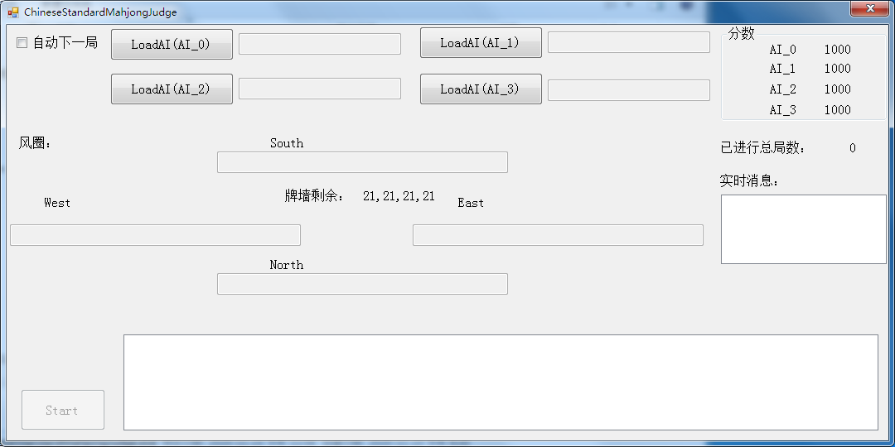
This is our local tester. It helps us find some key parameters after testing day and night. For example, we find the best parameter value for self drawing after 1 million tests.
In December, we found a serious bug after preliminary. Local tester was very important to help us finding it. After fixing this bug, our AI became much more stronger. Local tester is a very important tool to test and improve AI.

Slide 13
Monte Carlo method

Slide 14
“Mastering the game of Go with deep neural networks and tree search” is deepmind's paper on alphago . It discusses how to use Monte Carlo tree search and deep neural networks technology. How to learn from the results of this paper is our team’s research focus.

Slide 15
After a certain period of research, we found that the Monte Carlo tree search technology can achieve the ideal result in theory when the computing power is sufficient under the condition of a complete information game and a relatively single victory goal. But Mahjong is an incomplete information game, especially each draw is random, Monte Carlo tree search technology does not seem to apply, so we decided to adopt Monte Carlo method instead of using Monte Carlo tree search.

Slide 16
Simplify victory goal

Slide 17
The victory goal of Mahjong GB is diverse. It’s very different from traditional games, such as Go, Chinese Chess, etc.. There are 88 different combinations. It needs 8 points to win. At first glance, it’s very tricky. We conclude that this goal can be simplified with certain skills through sufficient summary and induction. We have summarized 16 ways to win.

Slide 18
Fan name | Win example | Reason for selection
THIRTEEN ORPHANS |  | It needs to be dealt with separately
LESSER HONORS AND KNITTED TILES |  | It needs to be dealt with separately
GREATER HONORS AND KNITTED TILES |  | It needs to be dealt with separately
KNITTED STRAIGHT |  | It needs to be dealt with separately
SEVEN PAIRS |  | It needs to be dealt with separately
Limited scope（Reversible Tiles, Full Flush, etc） | A hand composed completely of tiles that are vertically symmetrical. These tiles are: Bamboos – 1234589 Dots – 245689 Dragons – White | Small target limit and high efficiency in special processing respectively
STRAIGHT (MIXED STRAIGHT、PURE STRAIGHT) |  | A long dragon consisting of Chengshun is representative
ALL FIVES |  | Each component has special requirements
ALL TYPES |  | The chance of appearance is very high and has a high score
PURE SHIFTED CHOWS |  | The chance of appearance is high and has 16 points
MIXED TRIPLE CHOW |  | The chance of appearance is high and has 8 points
MIXED SHIFTED CHOWS |  | The chance of appearance is very high and has a high score
HALF FLUSH |  | It is the basis of some high-power fan types with words, for example, Big Four Winds, Small Four Winds.
TWO DRAGONS |  | The chance of appearance is very high, it has some points, which is the basis of some high-power fan types with words, for example, Big Three Dragons, Small Three Dragons.
ALL PUNGS |  | The chance of appearance is very high, it is the basis of some multi-shots and high-multipliers, such as Four Concealed Pungs, Three Concealed Pungs, etc.

Slide 19
Rollout generation

Slide 20
In the paper of deepmind about alphago, fast rollout policy network is a key technology. How to learn from it in Mahjong GB AI is the core work of our team. Drawing on the rollout to the end in the AlphaGo paper, massive statistical scores are used to obtain the basis for decision-making. The effectiveness of this is based on the speed and quality of the rollout. In fact, our algorithm can simulate more than 10,000 times in total within a one-second time limit. We have long-term observations and found that each candidate choice only needs about 300 simulations to make the result very convergent.

Slide 21
Our team began to register for the competition in April 2020. The competition was originally scheduled to be held in early July 2020. It takes only two months to develop and iterate training model. The team decisively decided to use human mahjong experience hard-coding to complete the writing of Rollout logic. This hard coding is based on gradually narrowing the distance between the current hand and the victory goal.
As shown in Figure, 12 of the 14 cards in the current hand have satisfied the LESSER HONORS AND KNITTED. Only Character 5 and Character 7 do not meet the requirement, so the distance target value for this is 2.

Slide 22
Quick dividing

Slide 23
I won gold medal of the Fight the Landlord in the 22nd Computer Olympiad. I have a special understanding of the Fight the Landlord's card dividing process. The performance of the the Fight the Landlord AI card dividing algorithm developed by me is very high. The use of machine learning in combination with an efficient card dividing process can reduce computing power by several orders of magnitude compared to only using machine learning. Mahjong AI also requires an efficient dividing process. In our Mahjong AI, due to the efficient process of dividing the cards, the subsequent rapid and efficient generation of Rollout becomes possible. In one second of actual testing, our card dividing algorithm can complete 1 million 14-card hand dividing on average. This is a solid foundation for us to perform a sufficient number of Rollout and Monte Carlo simulations.

Slide 24
Model the opponent

Slide 25
The related algorithm used in the traditional two-person complete information game has an underlying assumption: the opponent also evaluates the situation according to his own situation value evaluation system. Simply put, "I think the opponent will think so too." Humans play Mahjong with obvious different styles. The four-AI mahjong game assumes that the other three AIs at the same table also follow their own routines to understand the subsequent evolution of mahjong where the randomness has become huge due to the different order of drawing. After several months of online observation of the behavior of various AIs on the botzone ladder, we proved that this assumption is not true. The styles of different participating AIs are very different. In other words, it turns out that for the four AI mahjong rules, the understanding of "I think the other party will think so too" is wrong.

Slide 26
After a period of research and analysis, we concluded that it is difficult to be effective enough to analyze opponent information for the mahjong GB rules. The result of our own opponent's information logic analysis has actually led to the reduction of AI's offensiveness and some meaningless defenses. In the final weighing consideration, we give up the analysis of the opponent's information and use more computing power for the offense. The ladder practice has proved that a good offense is better than a defense, and the quickest victory is the key.

Slide 27
Other things to say

Slide 28
I think the time limit for C++ and Python in this competition is open to discussion. C++ is limited to 1 second and Python is limited to 6 seconds. This is unfair to C++ contestants in my opinion. Check the log record results in the evaluation system, deduct the general input and output，C++ contestants only have 800 milliseconds for various algorithms to run, but Python contestants still have 5500 milliseconds for calculation. I think it is fairer to increase the C++ time limit to 2 seconds.

Slide 29
Of course, there is a slight difference between the ranking of the ladder and the rules of the finals in the weight of victory. At this point, the core issue is the difference between winning faster and the biggest mathematical expectation of winning points. Further refinement is the need to win faster or more pursue self-drawing. We found the balance point parameters through local simulation of millions of games.

Slide 30
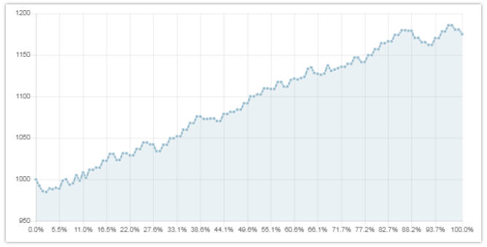
Ladder curve

Slide 31
Whether the mahjong competition system can effectively overcome the influence of luck, I also have certain thoughts. The specific theoretical analysis will not be carried out. Personally, this is a problem in another field. But there is an interesting experience to share with you. Our AI's ranking on the ladder began to take the lead around May 2020 before the game is confirmed to be adjusted to the Duplicate Format. Afterwards, we modified the source code to adapt to the Duplicate Format. This modification in mid-May caused a serious BUG. Then we found that the performance on the ladder was significantly worse, but the results of the Duplicate Format were better. This makes us relax our vigilance. The AI ​​with a serious bug participated in the preliminary round in mid-November and entered the final with the third preliminary. We discovered this bug in December when we modified our local tester to adapt to Duplicate Format. We modified this BUG, ​​and then found that the version after modified the BUG was significantly ahead of the version before the BUG was modified in local mass testing. However, the results of the modified version in several simulation games of the Duplicate Format dropped significantly in December. Perhaps the rules of the Mahjong game itself determine that the element of luck is very important. To fully evaluate the strength of Mahjong AI, a sufficient number of games is required. However, how to obtain the evaluation results stably and convergently with a relatively small number of games in the limited game time is another topic worthy of research.

Slide 32
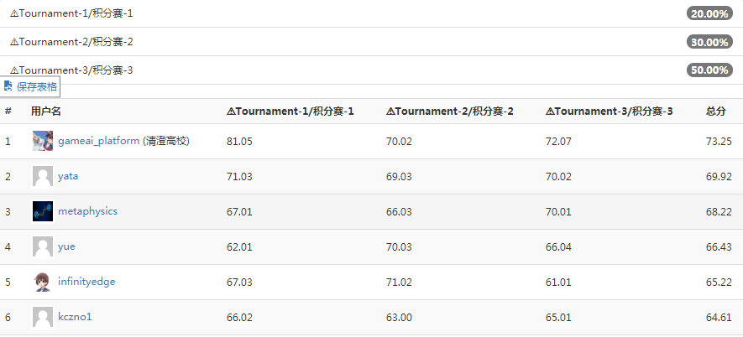
Third in the preliminary round to the final

Slide 33
Thanks!

