Slide 1
On Policy Gradient Applied to Mahjong
WeiZhiYu Technology co., ltd.
Lan-Zhou Zheng, Jing Sun, Jing-Hui Bi, He-Xiang Zhang

Slide 2
Outline
Introduction
Model Architecture
Data Processing
Supervised Learning
Reinforcement Learning
Experiments Results
Conclusion and Future Work

Slide 3
Introduction
Reinforcement learning (RL) is widely used in game AI.
Alpha Zero [Silver et al., 2017]
StarCraft II [Vinyals, 2019]
Suphx–Japanese Mahjong [Li, 2020]
…
Chinese Standard Mahjong: a multi-player imperfect-information game.
Large amount of hidden information

Slide 4
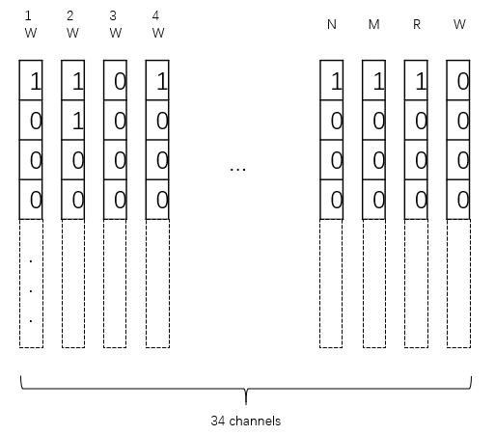
Model Architecture—Data Processing
Extract direct information & calculate other information.
Direct information: the payer’s cards…
Other information: if the player in Ting state…
One-hot encoding.
Unit : 1*34 vector.
34: the type of the cards.
Finally, the type of the cards
as the channel dimension.

Slide 5
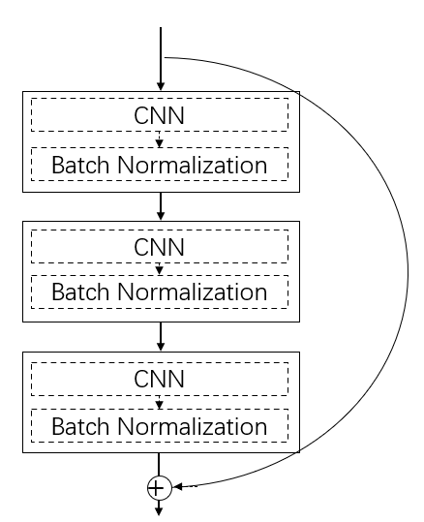
Model Architecture—Supervised Learning
A layer: CNN + Batch Normalization .
A block: 3/5 layers.
3 neural network models:
Discard, Peng, Chow.
Different in the number of output:
Discard: 34
Peng/Chow: 2
A layer
A block

Slide 6
Model Architecture—Reinforcement Learning
Supervised learning: has limitation.
Reinforcement learning + self play: break the limitation.
Policy gradient method:

Slide 7
Model Architecture—Reinforcement Learning
Design the reward is critical.
Win distance: the number of cards lacked to reach a win hand.
If got [1T, 1T, 2T, 2T, 3T, 3T, 7T, 7T, 7T, E, W, N, N, S]
Win hand [1T, 1T, 2T, 2T, 3T, 3T, 7T, 7T, 7T, W, W, N, N, N]
Win distance: 2
When discard a card:
The win distance increase: a negative reward
The win distance decrease: a positive reward
The win distance keep the same: 0
W
N

Slide 8
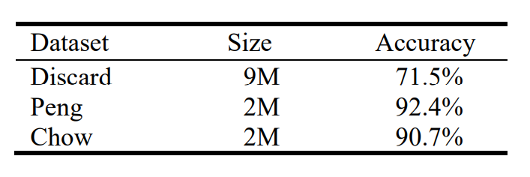
Experiments Results—Supervised Learning
Dataset size and the accuracy:
90% for training and 10% for testing.

Slide 9
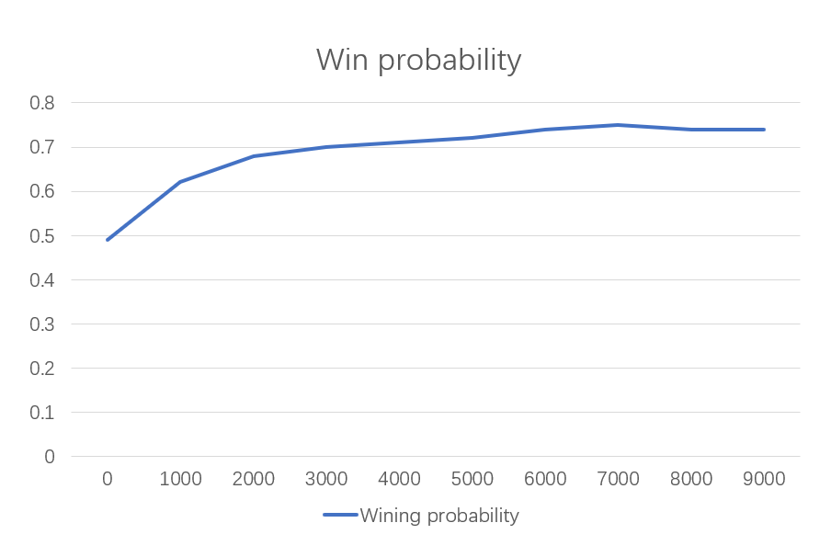
Experiments Results—Reinforcement Learning
Start with the supervised model.
Just for discard model.
The wining probability of RL model over SL model:

Slide 10
Conclusion and Future Work
Two-stage (Supervised learning + reinforcement learning) method is useful and could get good performance.
AC/A2C method should be further explored.

Slide 11
References
[Silver et al., 2017] Silver D , Schrittwieser J , Simonyan K , et al. Mastering the game of Go without human knowledge[J]. Nature, 2017, 550(7676):354-359.
[Vinyals, 2019] Oriol Vinyals, I. Babuschkin. Grandmaster level in StarCraft II using multi-agent reinforcement learning[J]. Nature.
[Li, 2020] J Li，S Koyamada，Q Ye，G Liu，HW Hon. Suphx: Mastering Mahjong with Deep Reinforcement Learning.2020

