Slide 1
A Simple Mahjong AI Based on Table and Probability
Tianyang Tao
taotianyang2020@ia.ac.cn
Team：自所小分队吧

Slide 2
Outline
Introduction
Table
Voting Model
Probabilistic Model
Conclusion

Slide 3
Introduction
We have two models to solve the problem, they are voting model and probabilistic model.
These two models are based on finding all ready hands which have the least distance to current hand.

Slide 4
Table
To get these ready hands, we make a table.
The table has all results of the 3X pattern which is produced by one kind of rank tile drawing x tiles and playing y tiles.(+x-y)
234568 (+1-1)→
123/456 234/456 234/567 234/678 345/678

Slide 5
Table
We enumerate the distance from small to large.
Exhaust the pair and honor tiles.
Look up the table for each kind of rank tile and combine them into a basic combination.
Check the number of score.

Slide 6
Table
We can get all ready hands which have the least distance to current hand in 0.1s.
If the limitation of x and y is 4(which is enough), the size of the table is 94MB.
(It may be the only meaningful work)

Slide 7
Voting Model
Each ready hand vote useless tiles with a weight.
The weight represents the easiness of win.
We design the weight optionally:
Multiply the remaining amount of absent tiles
Multiply the number of winning tiles
Multiply the number of quasi-melds
Play the tile which has the largest accumulated weight.
.

Slide 8
Probabilistic Model
Compute the probability of win in each state.
We need a magic parameter P_{alive}
Ready hand:
$$P_{n}\left(S\right)=P_{alive}^{3}\sum_{i=1}^{34}{P(a_{i})\max_{j}{P_{n+1}(S+a_{i}−a_{j})}}$$
Not ready hand:
$$P_{n}^{m}\left(S\right)=P_{alive}(\frac{m}{n}+\frac{n−m}{n}P_{alive}(\frac{m}{n−1}+\frac{n−m−1}{n−1}P_{alive}(…)))$$

Slide 9
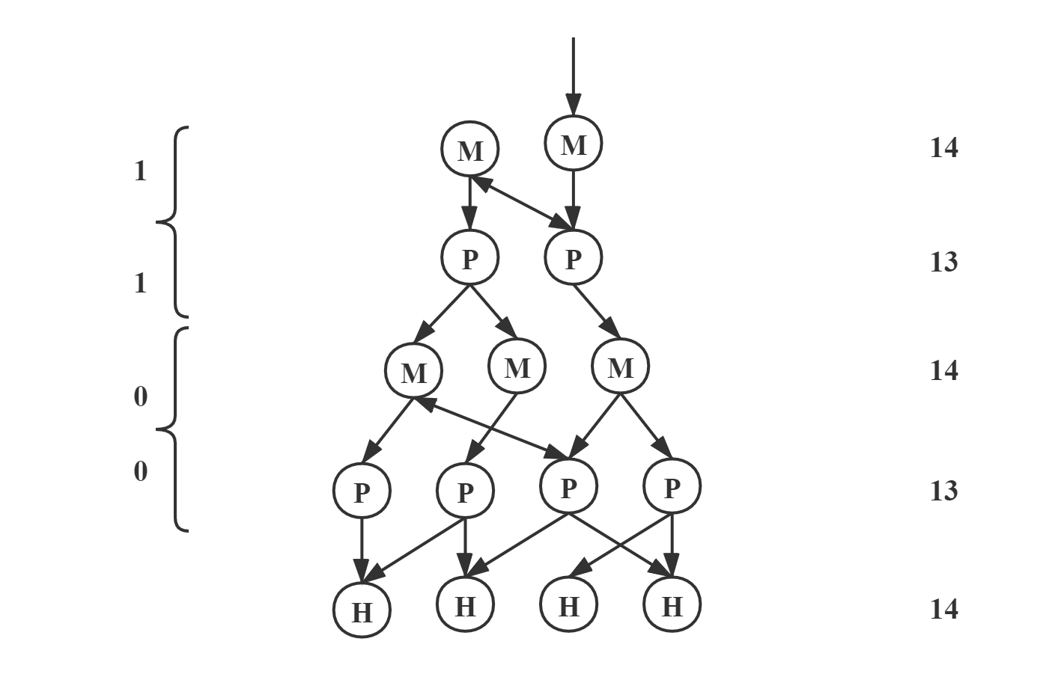
Probabilistic Model
Compute the probability through the transfer relationship network.
Play a tile according to the probability.

Slide 10
Conclusion
Because of the final exams, we only implement the voting model.
Although our approach is simple, I think it provides a new idea of Mahjong AI.

Slide 11
Thank you

